Slide 1
HOME WORK
FOR -- WHILE -- FUNCTION

Slide 2
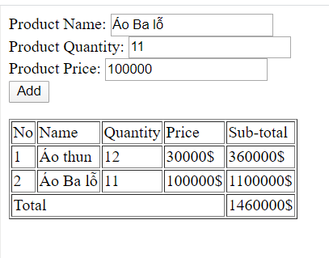

Slide 3


